Slide 1
Visual Secret Sharing Schemes Encrypting Multiple Images aysha mol n s6 mca no : 40

Slide 2
INTRODUCTION
Visual cryptography is a cryptographic technique which allows visual information (pictures,text,) to be encrypted in such a way that the decrypted information appears as a visual image.
One of the best well known technique was ” VISUAL SECRET SHARING SCHEME”.
The aim of this paper is to maximize the range of the access control of visual secret sharing (VSS) schemes encrypting multiple images

Slide 3
IDEAS OF THE SYSTEM
Binarization
Visual secret sharing
Encryption
Embedding with multiple images
Decryption

Slide 4
Till Now!!!!
Binarization
Share division
Embedding

Slide 5
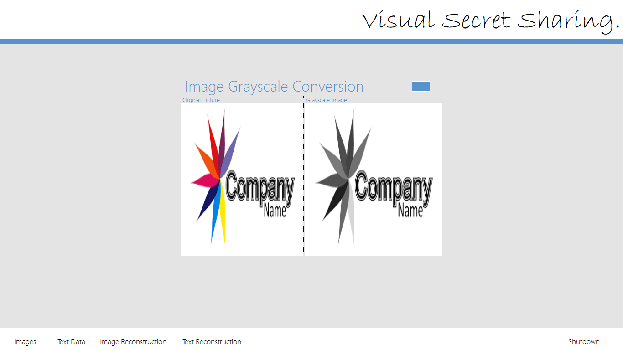
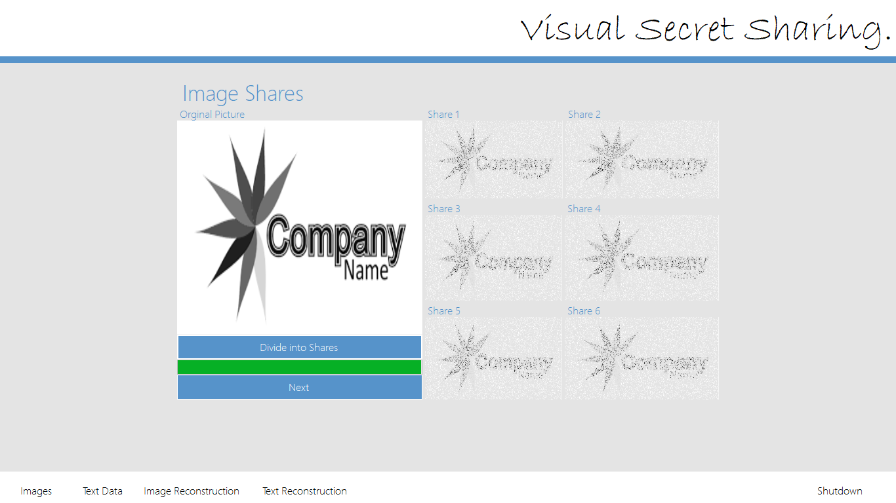
SCREENSHOTS
BINARIZATION
SHARE DIVISION

Slide 6
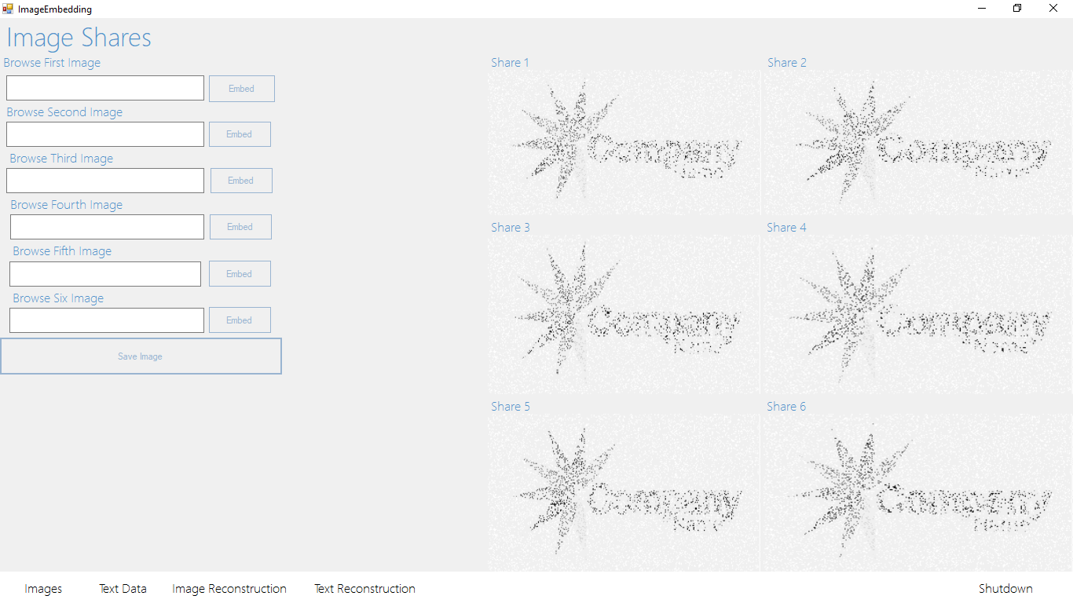
EMBEDDING

Slide 7
conclusion
In this paper we have implemented a scheme for multiple image sharing using visual cryptography. The proposed scheme is able to encrypt multiple number of images and decrypt them successfully without degrading the quality of the images. From the results obtained in this analysis, we conclude that the proposed scheme not only achieves the desired goals but also improves the efficiency of visual cryptography for numerous secret images. As the scheme is more secure, it can be used in defense, military and commercial applications.

Slide 8
THANK YOU !!!!

